Slide 1
Kensuke Koike
Deconstruction & Reconstruction Photography

Slide 2
Overview
About the artist
Inspirations
Photography Process
Works

Slide 3
About Kensuke Koike
Japanese Visual Artist
28 June 1980, Nagoya, Japan
Faculty of Arts & Design, IUAV University, Venice, Italy (2004-2007)
Solo Exhibitions: 2007-present
Lectures & Workshops: 2016-present

Slide 4
Inspiration: The Neglected
Old photographs at flea market.
Adding value
Creating new art
Viewer’s interest

Slide 5
Process
Collecting old photos
Selection
Brainstorming the image
Deconstruction
Reconstruction
The final piece

Slide 6
One minute is all it took
https://youtu.be/97WxfX26d90

Slide 7
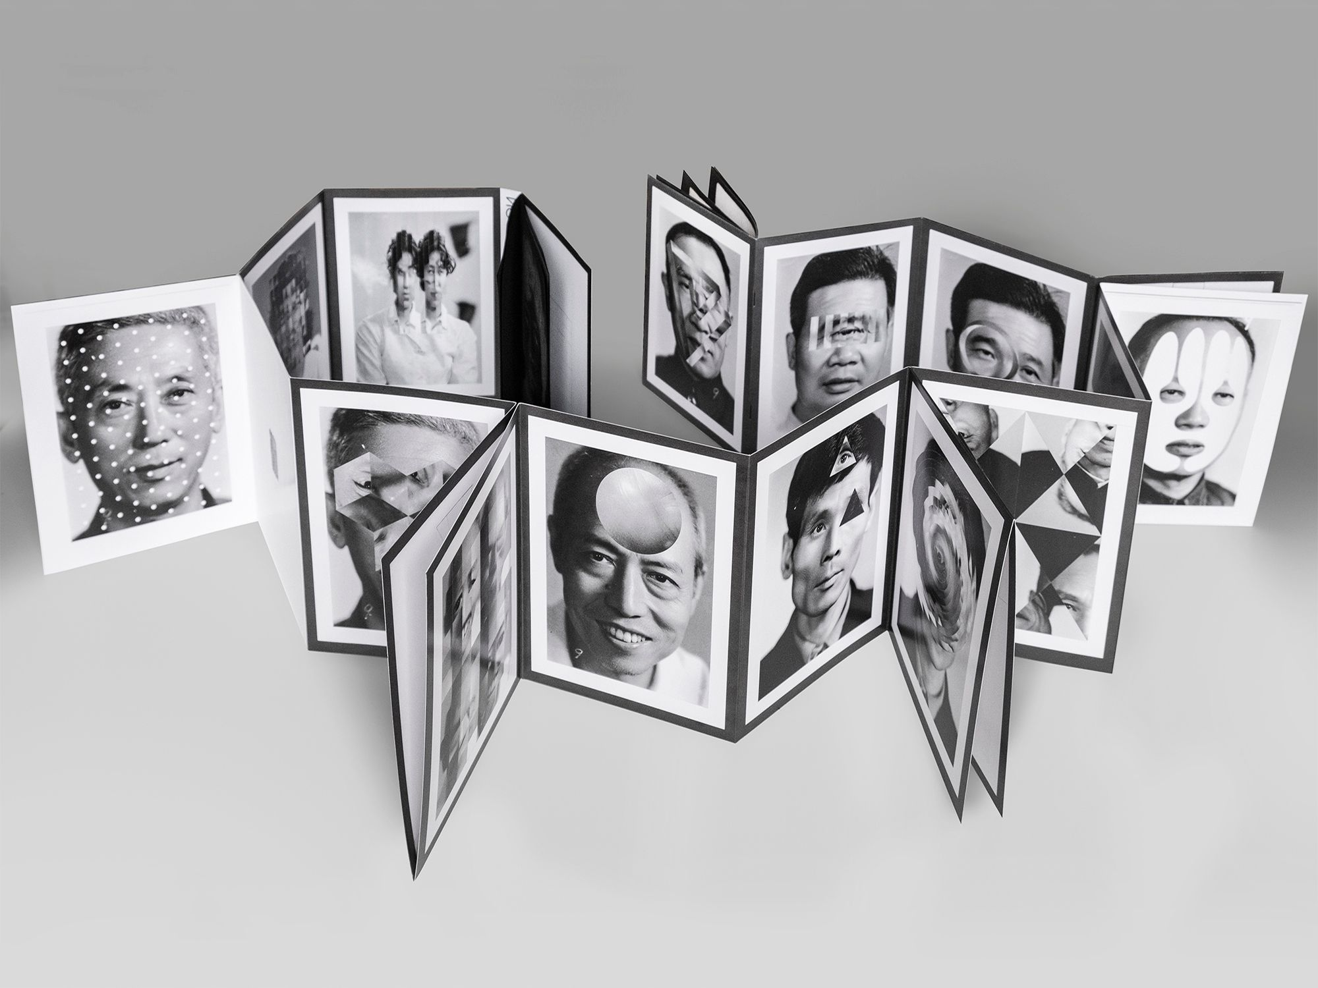
Works

Slide 8
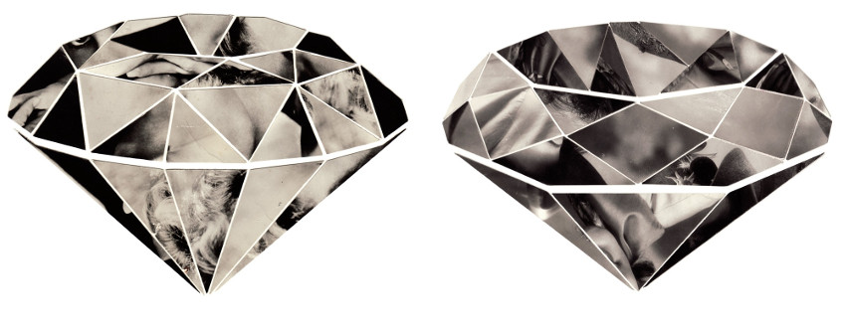
Diamonds of Memories

Slide 9
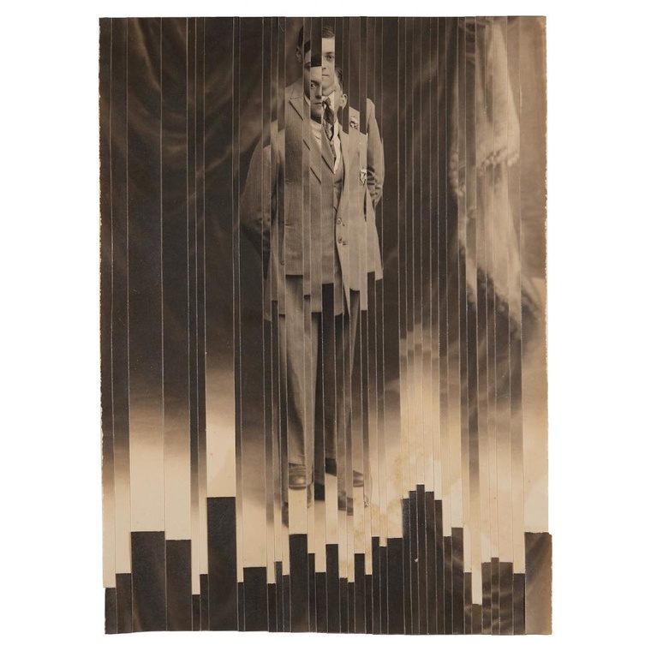
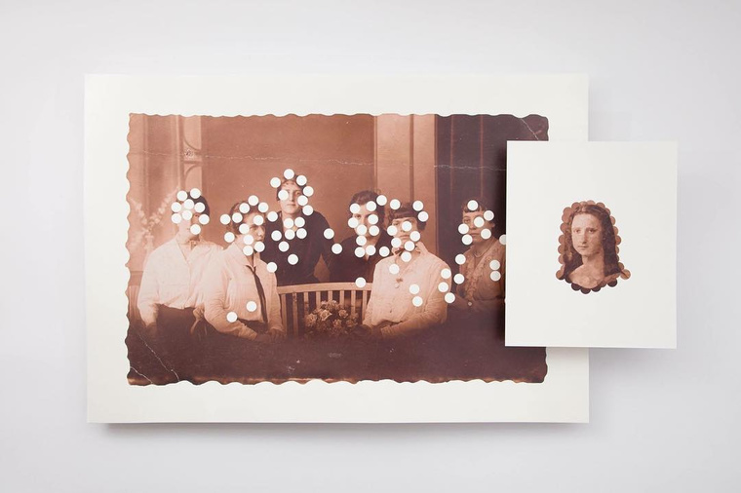

Slide 10
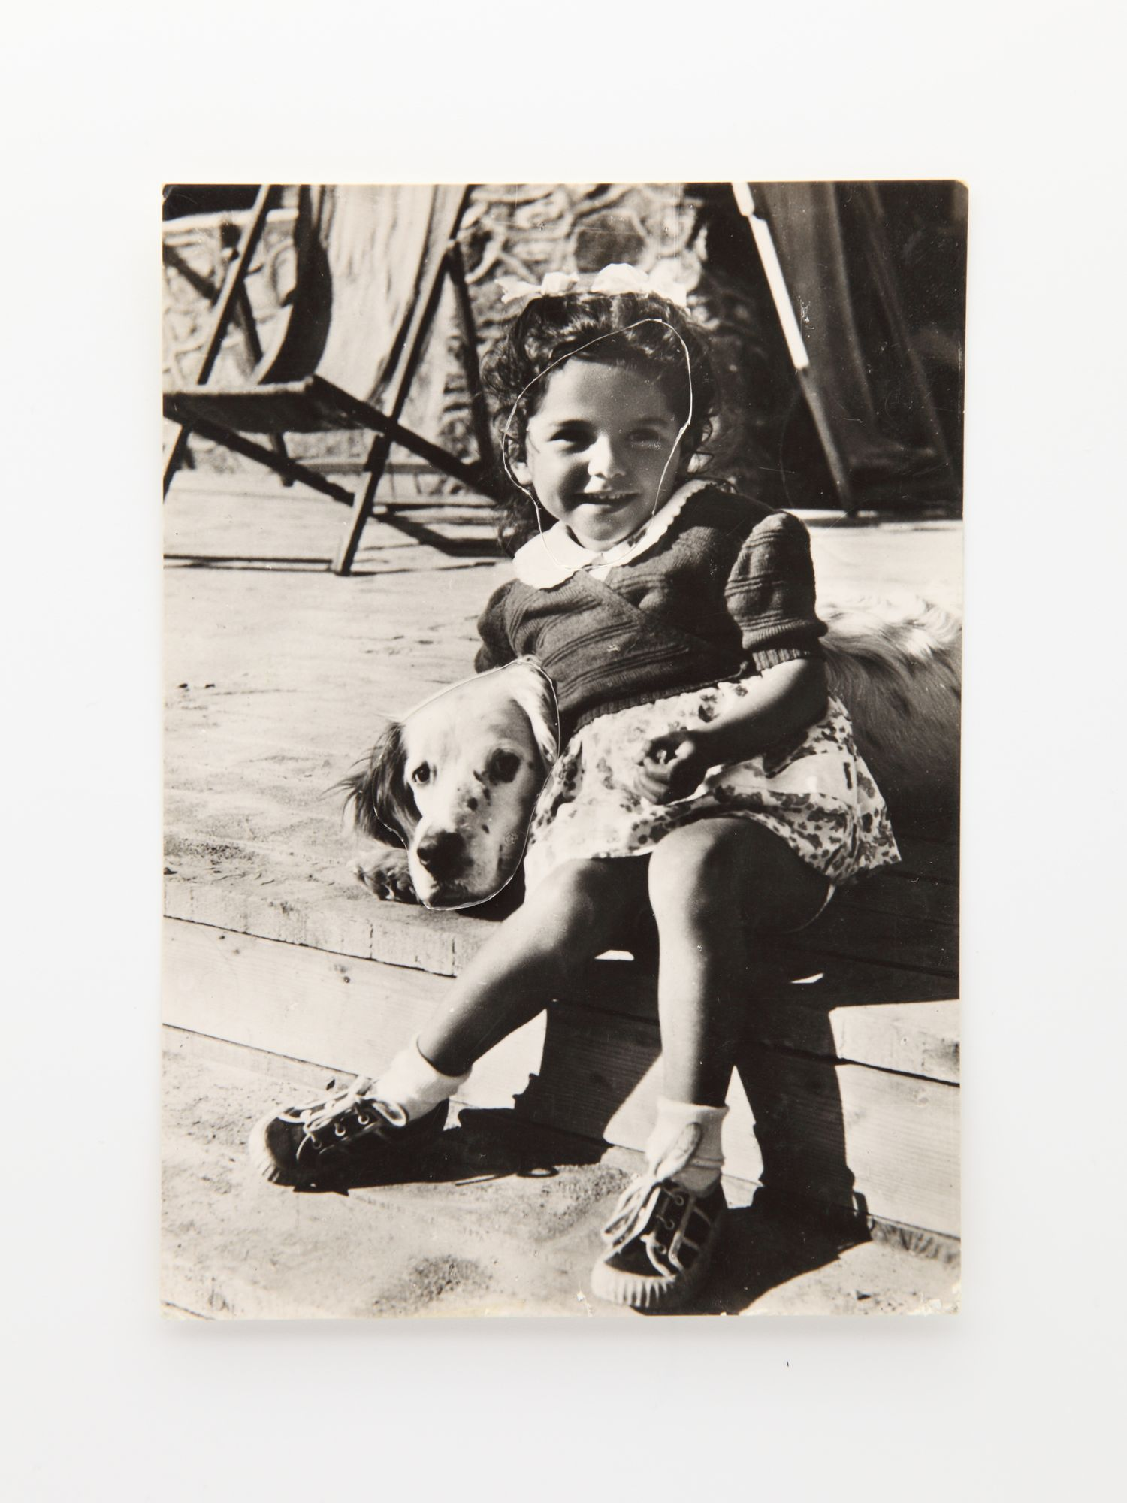
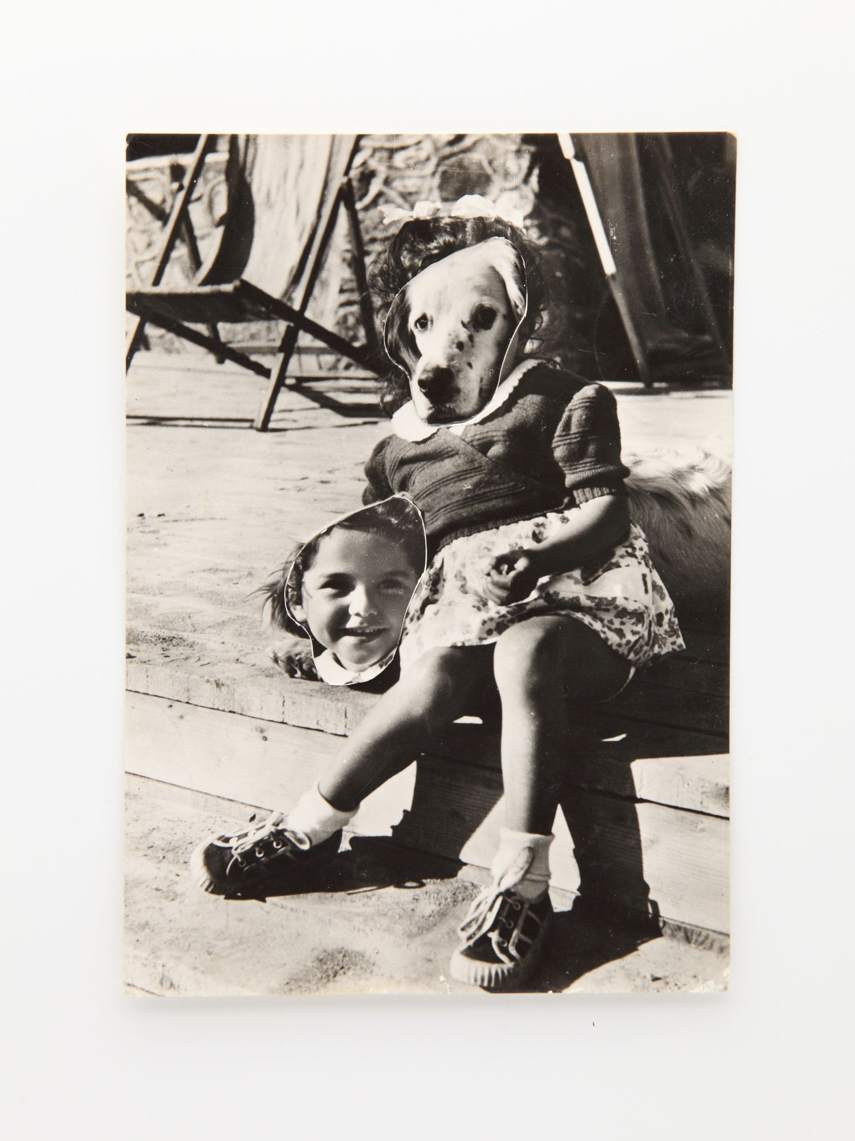
Sometimes Pleasing, Sometimes Bizarre But It Makes You Look Again

Slide 11
Thank you

Slide 12
References:
https://www.kensukekoike.com/cv/
https://pen-online.com/arts/kensuke-koike-deconstructs-photos-to-reconstruct/?scrolled=0
https://www.widewalls.ch/artists/kensuke-koike
https://www.beyondphotography.online/interviewed-kensuke-koike
https://www.beyondphotography.online/interviewed-kensuke-koike
https://www.lensculture.com/articles/kensuke-koike-and-thomas-sauvin-the-necessity-of-collaboration-in-kensuke-koike-and-thomas-sauvin-s-no-more-no-less

